Slide 1
Database System Concepts 数据库系统概论
瞿剑峰
jfqu@suda.edu.cn

Slide 2
本课程的目标
结合关系数据库系统深入理解数据库系统的基本概念，原理和方法。
掌握关系数据模型及关系数据语言，能熟练应用SQL语言表达各种数据操作。
掌握数据库设计的步骤和方法，通过对E-R模型的概念和方法、关系数据库规范化理论的学习及课程设计的训练，具备进行数据库应用系统设计与开发的能力。
对数据库领域研究有大致了解，激发在此领域中继续学习和研究的愿望，为学习数据库系统高级课程做准备。

Slide 3
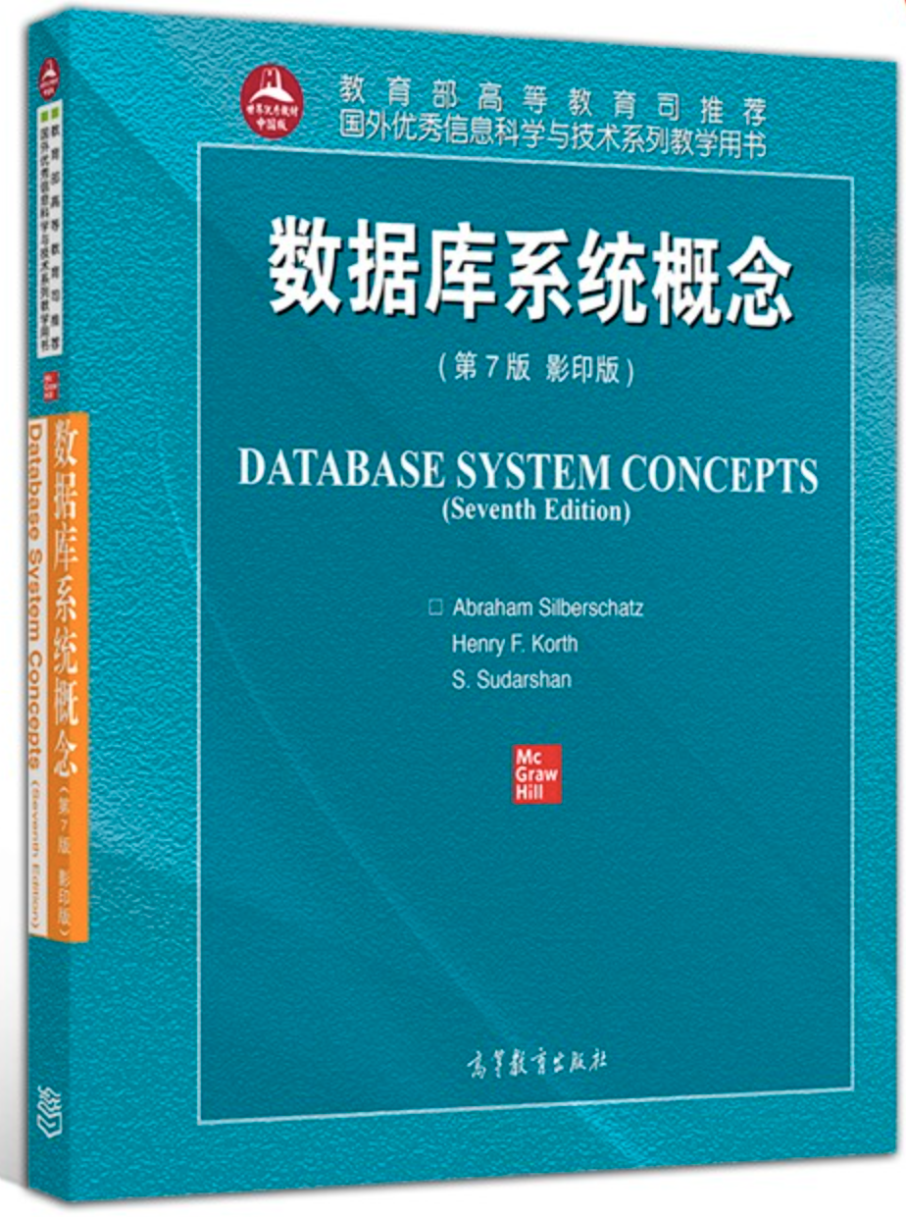



Slide 4
Chapter 1: Introduction 概论
本章内容特色
为全书内容铺底，广，浅
用山水画 写意手法 为全书做一个一个封面
远山淡抹，近水浓描
数据视图， 数据模型 ，DDL,DML ,
事务处理, 存储管理, 数据库管理,
数据库用户, 总体系统结构，
看远景，看轮廓，看全局。
不一定，全看懂，后面各章 会细细道来。

Slide 5
INTRODUCTION
Database-System Applications（应用）
Purpose of Database Systems（目的）
View of Data （视图）
Database Languages （语言）
Relational Databases （关系）
Database Design（设计）
Data Storage and Querying（存&查）
Transaction Management （事务）
Database Architecture（架构）
Database Users and Administrators（角色）

Slide 6
Database System: Introduction
数据：描述事物的符号记录
数据库：是长期储存在计算机内，有组织的，可共享的大量数据的集合。
数据库管理系统：计算机的基础软件。
数据库系统：是由数据库、数据库管理系统（及其应用开发工具）、应用程序和数据库管理员组成的存储、管理、处理和维护数据的系统。

Slide 7
Database System: Introduction
Database Management System (DBMS)（数据库管理系统）
Collection of interrelated data (database) （相互关联的数据）
Set of programs to access the data（存取程序）
Goal of a DBMS:
provides a way to store and retrieve database information that is both
convenient and
efficient.
Functions of DBMS: Management of Data (MOD)
Defining structure for storage data（存储）
Providing mechanisms for manipulation of data（操纵）
Ensure safety of data (system crashes, unauthorized access, misused, …)（安全）
Concurrent control in multi-user environment（一致性控制）

Slide 8
1.1 Database-System Applications
Database Applications:
Banking: all transactions
Airlines: reservations, schedules
Universities: registration, grades, student profile, ..
Sales: customers, products, purchases
Manufacturing: production, inventory, orders, supply chain
Human resources: employee records, salaries, tax deductions
Databases touch all aspects of our lives

Slide 9
1.2 Purpose of Database Systems
假设在文件中，数据以CSV的格式组织：
Actors.txt（name, gender, country）结构如下：
"Jacky Chan", “male”, "China"
"Tony Jaa", “male”,"Thailand"
"Tom Hanks", “male”, "USA"
“Jennifer Lawrence”, “female”, ”USA”
Movies.txt(name, protagonist, year) 结构如下：
"Rush Hour", “Jacky Chan”, 1998
"Hunger Game", “Jennifer Lawrence”,2012
"Saving Private Ryan", “Tom Hanks”, 1998
"Sally", “Tom Hanks”, 2016

Slide 10
1.2 Purpose of Database Systems
In the early days, database applications were built on top of file systems
Drawbacks of using file systems to store data:
Data redundancy and inconsistency （数据冗余和不一致性）
Multiple file formats, duplication of information in different files
Difficulty in accessing data （数据存取困难）
Need to write a new program to carry out each new task
Data isolation — multiple files and formats （数据孤立）
Integrity problems （完整性问题）
Integrity constraints (e.g. account balance > 0) become part of program code
Hard to add new constraints or change existing ones

Slide 11
Drawbacks of using file systems (cont.)
Drawbacks of using file systems to store data: (cont.)
Atomicity of updates （原子性问题）
Failures may leave database in an inconsistent state with partial updates carried out
E.g. transfer of funds from one account to another should either complete or not happen at all
Concurrent access by multiple users(并发访问问题)
Concurrent accessed needed for performance
Uncontrolled concurrent accesses can lead to inconsistencies
E.g. two people reading a balance and updating it at the same time
Security problems（安全性问题）
Database systems offer solutions to all the above problems
Solution

Slide 12
1.3 View of Data and Data Abstraction
Physical level: describes how a record (e.g., customer information) is stored in disk.
By sequential file, pointer, or hash structure, …
Logical level: describes data stored in database, and the relationships among the data.
type customer = record name : string; street : string; city : string;
income : integer; end;
View level: application programs hide details of data types. Views can also hide information (e.g., income) for security purposes.

Slide 13
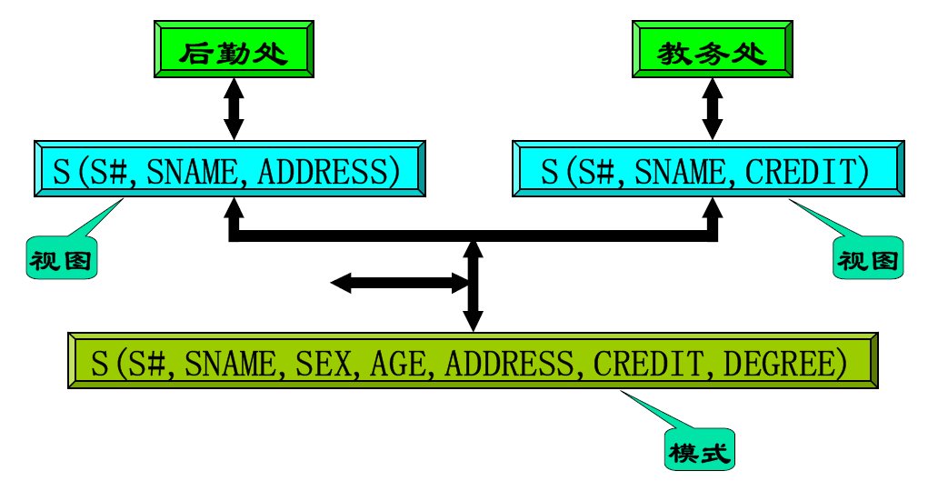

Slide 14
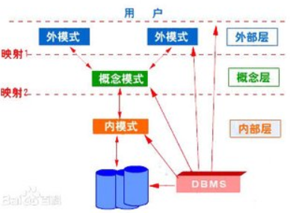

Slide 15
1.3.2 Instances 实例and Schemas模式
Schema – the logical structure of the database, the design of the database
e.g., the database consists of information about a set of customers and accounts and the relationship between them
Analogous to type information of a variable in a program
Physical schema: database design at the physical level
Logical schema: database design at the logical level
account
create table account (account-number char(10), balance integer)
type customer = record name : string; street : string; city : string; end;
customer

Slide 16
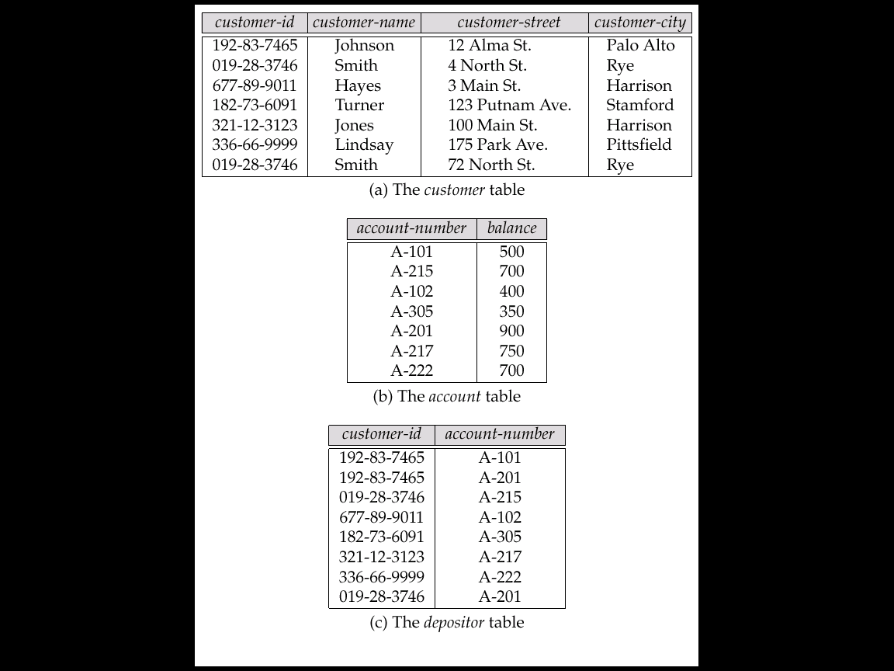
Instances and Schemas (cont.)
Instance – the actual content of the database at a particular point in time
Analogous to the value of a variable
Instance
Schema
create table account (account-number char(10), balance integer)

Slide 17
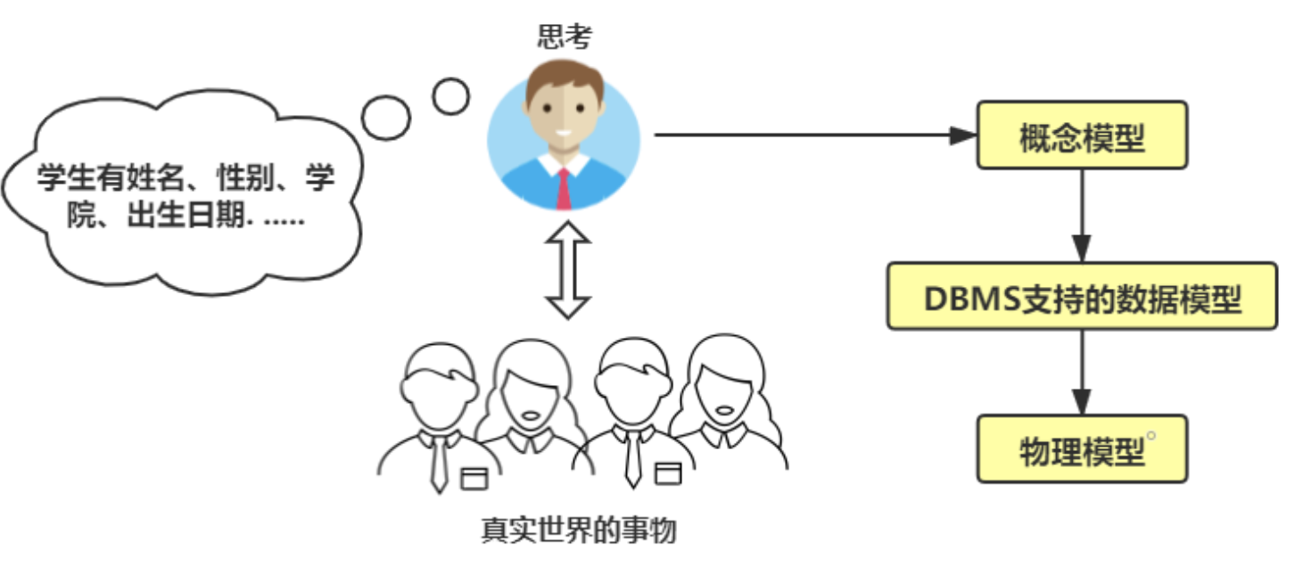
1.3.3 Data Models数据模型

Slide 18
1.3.3 Data Models数据模型
数据模型是对现实世界进行数据抽象的结果
是一个描述数据、数据联系、数据语义以及一致性约束的概念工具的集合。
数据抽象可以分级进行
一级→ 概念模型（实体-联系、ODL<Object Definition Language>）
按用户的观点来对数据和信息建模
二级→ 逻辑模型（关系、网状、层次、面向对象、对象关系、半结构化等）
从计算机实现的观点来对数据建模

Slide 19
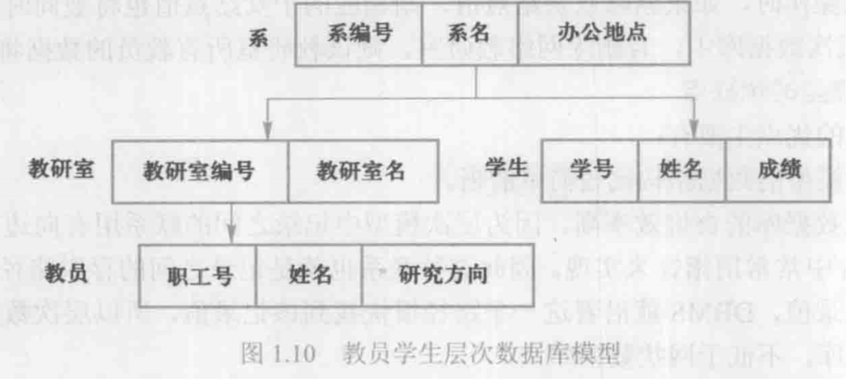
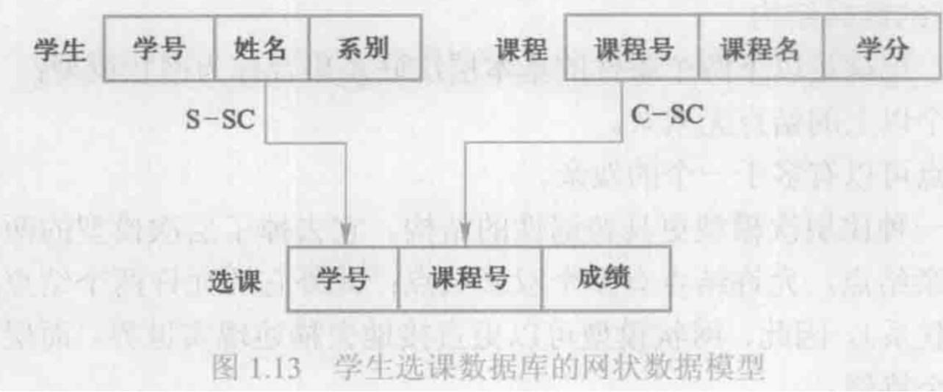
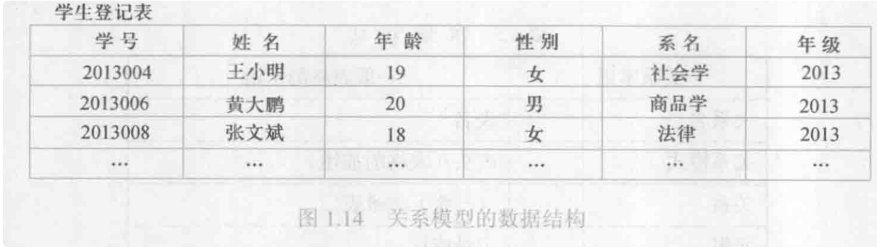
1.3.3 Data Models数据模型

Slide 20
Category of Data Models
Category of Data Models:
Entity-Relationship model
Relational model
Object-oriented model
Semi-structured data models
Extensible Markup Language (XML)
Older models:
Network model and
Hierarchical model

Slide 21
1.4 Database Languages
Data Definition Language (DDL):
Specification notation for defining the database schema
E.g. create table account (account-number char(10), balance integer)
Data Manipulation Language (DML)
To express database queries or updates
E.g. Select account-number from account where balance >1000
SQL (Structured Query Language): a single language for both

Slide 22
1.4.1 Data-Manipulation Language (DML)
Language for accessing and manipulating the data organized by the appropriate data model
DML also known as query language
For retrieval, insertion, deletion, modification (update)
Two classes of languages
Procedural DMLs – user specifies what data is required and how to get those data
Declarative DMLs (Nonprocedural DMLs) – user specifies what data is required without specifying how to get those data
E.g. In SQL: Select account-number from account where balance > 700
SQL is the most widely used query language

Slide 23
1.4.2 Data-Definition Language (DDL)
Specification notation for defining the database schema
E.g. create table account (account-number char(10), balance integer)
Define:
Attributes name
Data type
Consistency constraints (integrity constraints)
Domain constraints:
e.g. assets are integer type
Assertions: e.g. assets >= 0
Authorization: for different users
参照完整性….
create table branch (branch-name char(15), branch-city char(30), assets integer, primary key (branch-name), check (assets >= 0))

Slide 24
1.5 Relational Databases
Definition 1: A Relational Database is a database that is perceived(感知) by the users as a collection of time-varying, normalized（标准化） relations (tables).
Perceived by the users: the relational model apply at the view level and logical levels.
Time-varying: the set of tuples changes with time.
Normalized: contains no repeating group (only contains atomic value).
The relational model represents a database system at a level of abstraction that removed from the details of the underlying machine, like high-level language.
C, PASCAL ,PL/1
DBMS environments
assembler
Relational DBMS
machine
Relational
Data Model

Slide 25
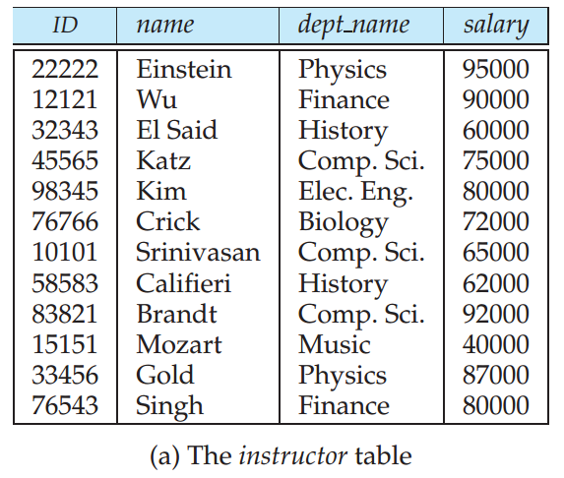
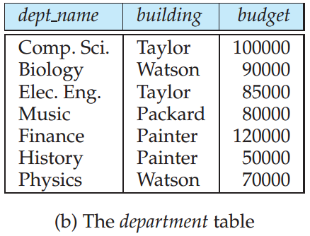
1.5.1 Tables
Definition 2: A Relational Database is a database that is perceived by its users as a collection of tables (and nothing but tables).

Slide 26

1.5.2 Data-Manipulation Language
SQL (Structured Query Language) : widely used
E.g. find the names of all instructors in the History department
Output:
name

Slide 27
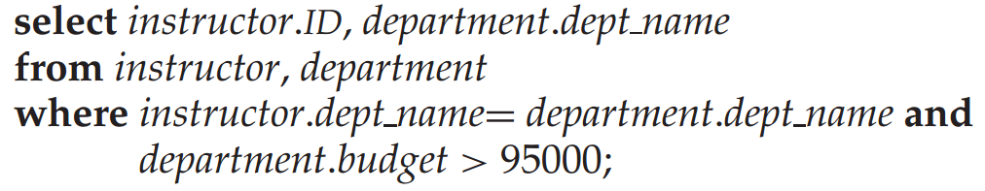
1.5.2 Data-Manipulation Language
SQL (Structured Query Language) : widely used

Slide 28
SQL (Structured Query Language)
E.g. find the balances of all accounts held by the customer with customer-id 192-83-7465 select account.balance from depositor, account where depositor.customer-id = ‘192-83-7465’ and depositor.account-number = account.account-number

Slide 29
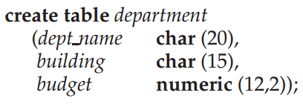
1.5.3 Data-Definition Language
SQL provides DDL to define database schema:
Tables

Slide 30
1.5.3 Data-Definition Language
SQL provides DDL to define database schema:
Tables
E.g. create table account (account-number char(10), balance integer)
Assertions (ref. p.132)
E.g. create assertion balance-constraint
check account.balance >= 1000
integrity Constraints (ref. p.129)

Slide 31
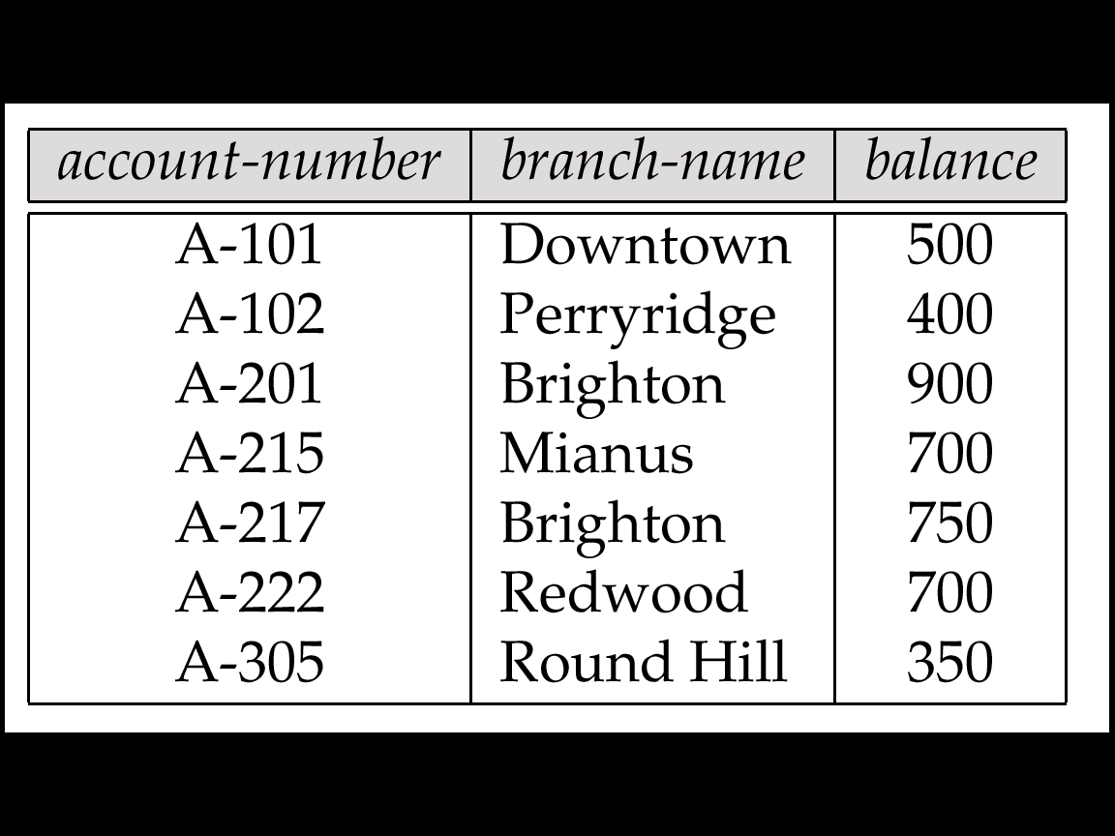
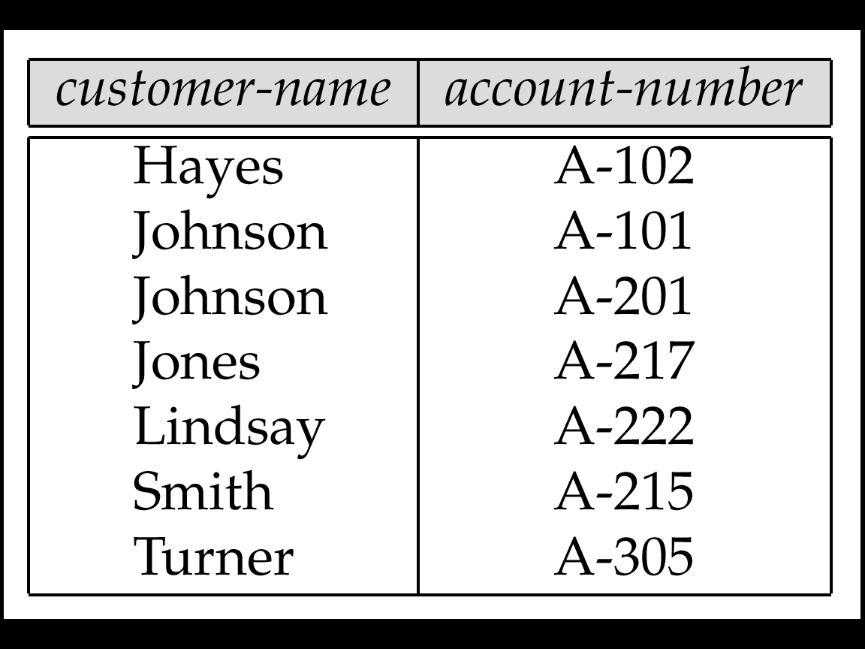
Referential Integrity Constraint
3. account
存款帳
create table account (account-number char(10), branch-name char(15), balance integer,
primary key (account-number),
create table depositor (customer-name char(20), account-number char(10),
primary key (customer-name, account-number),
foreign key (account-number) references account,
references
4. depositor
存款戶

Slide 32
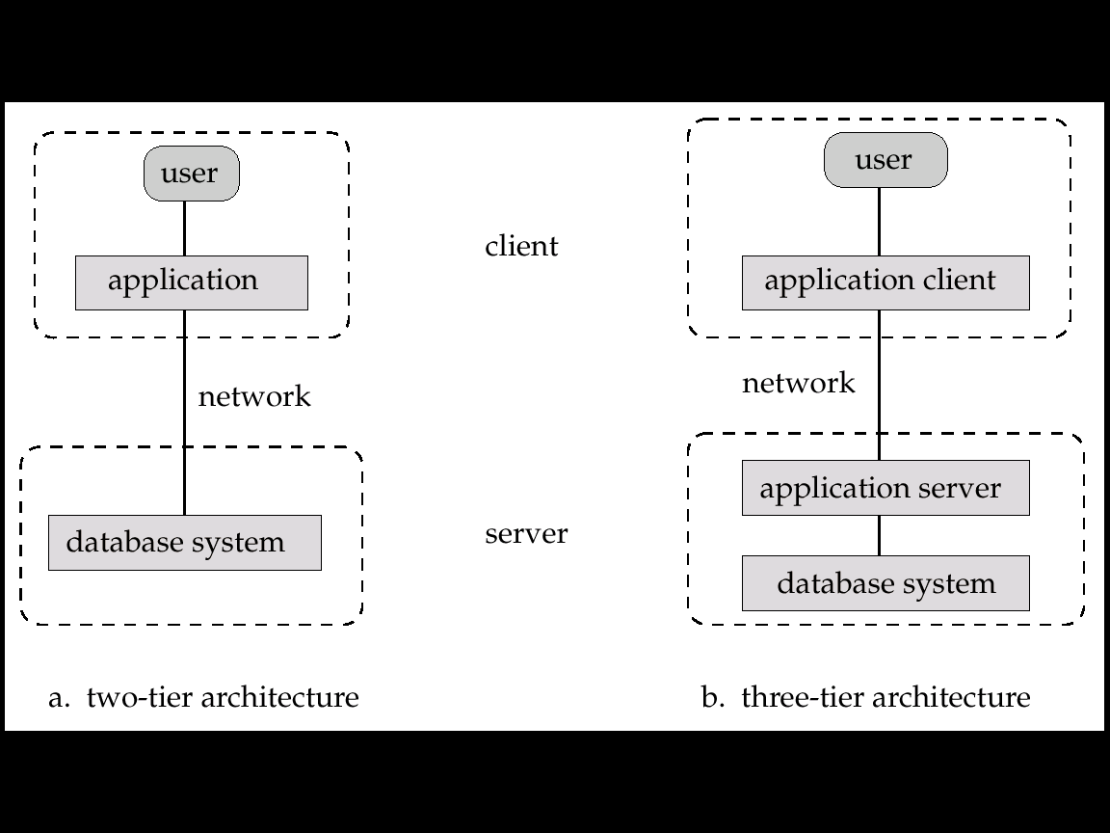
1.5.4 Data Access from Application Programs
Application programs generally access databases through one of
Language extensions to allow embedded SQL
Application program interface (e.g. ODBC/JDBC) which allow SQL queries to be sent to a database
ODBC: Open Database Connectivity for C
JDBC: Java Database Connectivity for Java language
ODBC/JDBC

Slide 33
1.6 Database Design
Requirement Analysis（需求分析） –Characterize fully the data needs of the prospective database users
Logical Design（逻辑设计）– Deciding on the database schema. Database design requires that we find a “good” collection of relation schemas.
Business decision – What attributes should we record in the database?
Computer Science decision – What relation schemas should we have and how should the attributes be distributed among the various relation schemas?
Physical Design（物理设计） – Deciding on the physical layout of the database

Slide 34
Database Design for a University Organization
Here are the major characteristics of the university：
The university is organized into departments.
Each department has a list of courses it offers.
Instructors are identified by their unique ID.
Students are identified by their unique ID.
The university maintains a list of classrooms, specifying the name of the building, room number, and room capacity. The university maintains a list of all classes (sections) taught. The department has a list of teaching assignments specifying, for each instructor, the sections the instructor is teaching. The university has a list of all student course registrations, specifying, for each student, the courses and the associated sections that the student has taken (registered for)

Slide 35
Database Design for a University Organization
A real university database would be much more complex than the preceding design.
We use a simplified model to help you understand conceptual ideas without getting lost in details of a complex design.

Slide 36
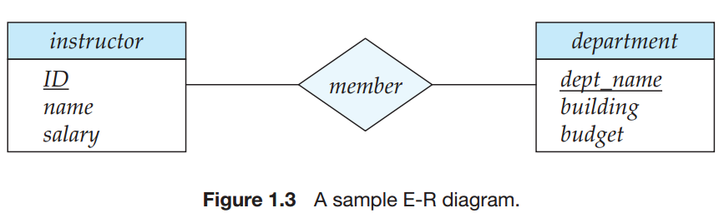
1.6 Database Design
Models an enterprise as a collection of entities and relationships
Entity（实体）: a “thing” or “object” in the enterprise that is distinguishable from other objects
Described by a set of attributes
Relationship（关系）: an association among several entities
Represented diagrammatically by an entity-relationship diagram:

Slide 37
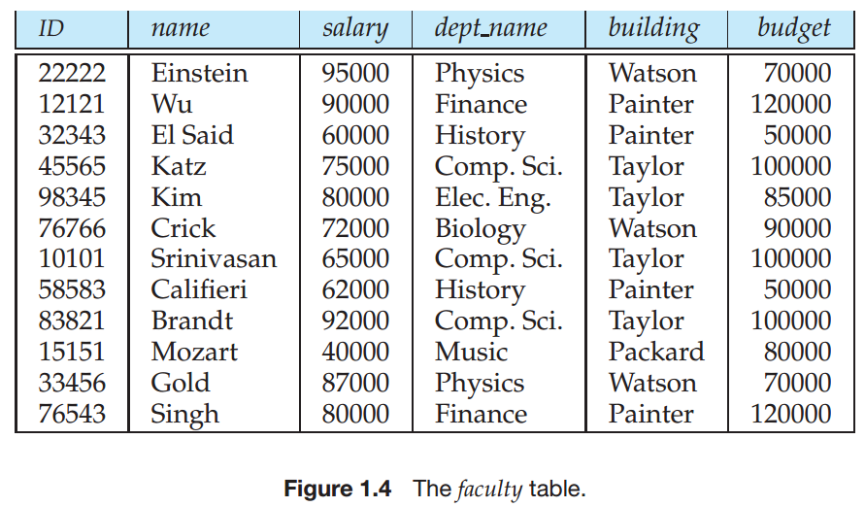
1.6 Database Design
The mainly method to design a good relational database
Normal Form（范式）: the definition on level of DB to be a standard relational database.
Functional dependencies（函数依赖）:

Slide 38
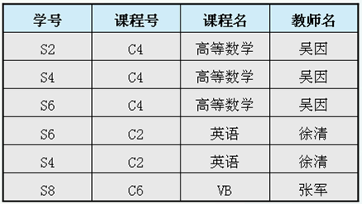
例：设有一个关系模式
教学（学号，课程号，课程名，教师名）
很显然，该关系模式的码为（学号，课程号），所以在每个元组上，学号和课程号的值均不能为空值。

Slide 39
虽然这个模式只有4个属性，但在使用过程中会出现以下几个问题：
数据冗余。如果一门课程有多个学生选修那么这门课程的课程名和任课老师姓名也要重复多次
操作异常。由于数据的冗余在对数据操作时引起各种异常：
修改异常。如要修改某课程的任课教师，而该课程由多人选修的话，都要逐个修改。若有一个元组的教师姓名未改，就会造成数据不一致现象。
插入异常。插入尚无学生选修的课程时，“学号”为空值
删除异常。在前表中如果删除学生S8的选课元组，那么就要把‘VB’这门课程和教师姓名也删除了。这也是一种不合适的现象。
因此，关系模式‘教学’的设计不是一个合适的设计。

Slide 40
1.8 Data Storage and Querying
Components of Database System
Query Processor
Helps to simplify to access data
High-level view
Users are not be burdened unnecessarily with the physical details
Storage Manager
Require a large amount of space
Can not store in main memory
Disk speed is slower
Minimize the need to move data between disk and main memory
Query
DBMS
Language Processor
Query Processor
Optimizer
Operation Processor
Access Method
Storage Manager
File Manager
Goal of a DBMS: provides a way to store and retrieve data that is both convenient and efficient.
Database

Slide 41
Storage Management (cont.)
Components of Storage manager:
Authorization and Integrity完整性 Manager
Tests for the satisfaction of integrity constraints（完整性）
Checks the authority of users to access data（权限）
Transaction Manager
Ensure the database in a consistent state (correct) after failures（失败）
Ensure that concurrent transaction executions proceed without conflicting（并发）
File Manager
Manages the allocation of space on disk（空间）
Manages the data structures used to representation data stored（组织）
Buffer manager
Fetches data from disk into main memory（读取）
Decides what data to cache in main memory（置换）

Slide 42
1.8.1 Storage Management
Storage Manager
is a program module
that provides the interface between the low-level data stored and the application programs and queries submitted to the system.
The storage manager implements several data structures as part of the physical system implementation:
Data files: store database itself
Data Dictionary: store metadata
Indices: provide fast access to data items that hold particular values

Slide 43
1.8.2 The Query Processor
DDL Interpreter
Interprets DDL statements
write the definitions (schema, view, ..) into the data dictionary数据字典
DML Compiler
Translates DML statements into an evaluation plan计算方案 (or some evaluation plans) which consists low-level instructions
Query Optimization查询优化: picks the lowest cost evaluation plan
Query Evaluation Engine:
execute low-level instructions generated by the DML Compiler

Slide 44
1.9 Transaction Management
Transaction:
A transaction is a collection of operations that performs a single logical function in a database application
Atomicity: all or nothing
Failure recovery manager
ensures that the database remains in a consistent (correct) state,
Failure:
system failures (e.g., power failures and operating system crashes)
transaction failures.
Concurrency-control manager
controls the interaction among the concurrent transactions, to ensure the consistency of the database.

Slide 45
1.10 Data Mining and Analysis
Data Analysis and Mining
Decision Support Systems
Data Analysis and OLAP (Online analytical processing),
Data Warehousing
Data Mining

Slide 46
Decision Support Systems
Decision-support systems
are used to make business decisions,
often based on data collected by on-line transaction systems.
Examples of business decisions:
What items to stock?
What insurance premium to change?
To whom to send advertisements?
Examples of data used for making decisions
Retail sales transaction details
Customer profiles (income, age, gender, etc.)

Slide 47
Data Mining数据挖掘 (ch.15)
Data mining:
seeks to discover knowledge automatically in the form of statistical rules and patterns from large databases. E.g. Young women buy cars.
is the process of semi-automatically analyzing large databases to find useful patterns
Prediction based on past history
Predict if a credit card applicant poses a good credit risk, based on some attributes (income, job type, age, ..) and past history
Predict if a pattern of phone calling card usage is likely to be fraudulent
Descriptive Patterns
Associations（关联）
Find books that are often bought by “similar” customers. If a new such customer buys one such book, suggest the others too. (library)
Associations may be used as a first step in detecting causation
引起;因果關係

Slide 48
1.12.1 Database Users and User Interfaces
Application programmers
interact with system through DML calls
Sophisticated users
Submit query without write program
E.g. OLAP (Online analytical processing), data mining tools
Naive users (end user)
invoke one of the permanent application programs that have been written previously
E.g. people accessing database over the web, bank tellers, clerical staff
Notes:
程序员
老手
小白

Slide 49
1.12.2 Database Administrator
Database Administrator:
Coordinates（协调） all the activities of the database system;
has a good understanding of the enterprise’s information resources and needs.
Database Administrator's Duties:
Schema definition
Storage structure and access method definition
Schema and physical organization modification
Granting of authorization for data access
Routine maintenance
Periodically backup database
Upgrade system e.g. disk
Monitoring performance
…

Slide 50
1.13 History of Database Systems
1950s – early 1960:
Tapes: sequentially
Application: Payroll（工资单）
Processing of data consisted of reading data from one or more tapes and writing data to a new tape.
Late 1960s -- 1970s:
Disk: direct access
Codd proposed Relational Model, … ➔ Turing Award
1980s:
System R: IBM Res. Lab. ➔ IBM DB2, Oracle, Ingress, DEC Rdb
Replaced Network/Hierarchical model
Research: parallel database, distributed database, object-oriented, …
Early 1990s:
Parallel database
Object-Relational
Late 1990s:
World Wide Web was explosive growth
Database were used much more than ever before
Database had to support Web interfaces to data

Slide 51
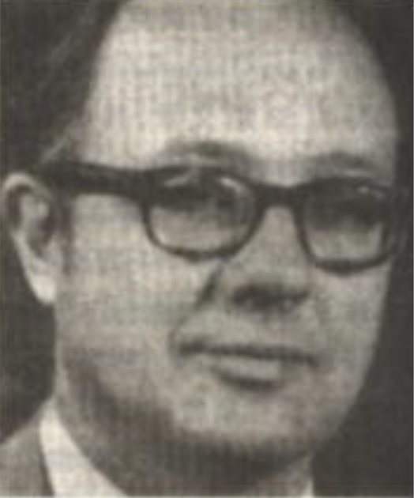
Turing Award
Charles W. Bachman(查尔斯 • 巴赫曼) 1973
主持设计与开发了最早的网状数据库管理系统IDS，它的设计细想和技术直接影响了后来的数据库。他还促成了数据库标准的制定，即DDL和DML规范说明。

Slide 52
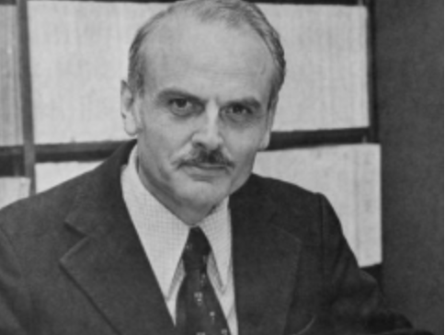
Turing Award
Edgar F. Codd(埃德加 • 科德) 1981
于1970年6月发表了题为“A Relational Model of Data for Large Shared Data Banks”一文，首次明确而清晰地为数据库系统提出了一种崭新的模型，即关系模型。一经提出迅速商品化。

Slide 53

Turing Award
James Gray(詹姆斯 • 格雷) 1998
在事务处理技术上的创新性思维和开拓性工作，使他成为该技术领域公认的权威。在解决保障数据的完整性 安全性 并行性，以及从故障中恢复方面发挥了十分关键的作用。

Slide 54

Turing Award
Michael Stonebraker (迈克尔.斯通布雷克) 2015
对现代数据库系统底层的概念与实践所做出的基础性贡献。
在数据库领域以多产而著称，“发明了许多几乎所有现代数据库系统所用的概念，创办了无数成功的数据库技术公司”

Slide 55
End of Chapter 1

